Slide 1

Predicting 30-day mortality due to sepsis using machine learning
Greg Gipson
https://github.com/gregg2024/AI_in_HC_public

Slide 2
Disclaimer
Note that due to the nature of machine learning models, rerunning the analyses on the same data may lead to slightly different results. Given this, the student should not be concerned if their results do not exactly match those contained in this tutorial.

Slide 3
Background
Objective: Predicting 30-day mortality for MIMIC-III patients with sepsis using machine learning
Sepsis is a significant risk to ICU patients and cause for in-hospital mortality. Predicting sepsis and being able to address and treat the causes can be life saving for patients in the ICU.
There are ample research papers seeking to predict the 30-day mortality rate for MIMIC-III patients with sepsis. One such paper, "Predicting 30-days mortality for MIMIC-III patients with sepsis-3: a machine learning approach using XGboost" by Hou et al, seeks to use XGBoost as an alternative means to prediction versus more traditional approaches such as SAPS-II score prediction and logistic regression. The paper concludes that XGBoost provides superior results to the traditional approaches.
This tutorial will look to reproduce the XGBoost results and compare to two new machine learning approaches (LightGBM and CatBoost) along with ways to finetune hyperparameters for these models which may yield improved prediction ability relative to the work done by the authors of the referenced paper.

Slide 4
Loading and Preparing Data
#Load a few of the libraries/functions needed for analysis
import pandas as pd
import numpy as np
import matplotlib.pyplot as plt
!pip install xgboost
from xgboost import XGBClassifier
from sklearn.model_selection import train_test_split
Patient data was extracted by the authors from the MIMIC-III database with the following characteristics as defined in the paper.
Initial Universe: Adult patients who were diagnosed with sepsis-3
Inclusion criteria were:
Patients older than 18 years old
length of stay in the ICU was over 24 hours
patients diagnosed with sepsis according to icd-9 codes for sepsis, severe sepsis, and septic shock
Exclude patients older than 89 years
Include only the first admission for patients with multiple admissions
Remove variables with more than 20% observations missing
For those with less than 20% missing data or randomly missing data, the authors explored and visualized them with Templ's method and multiple imputation method for further analysis
To ensure consistent data with the research paper, we will use the same data file available via download on the site: https://www.ncbi.nlm.nih.gov/pmc/articles/PMC7720497/. Scroll down towards the bottom of the page under "Supplementary information". Click on the link, download the file, and save to a local machine or to Google Drive. The file is also located in the Github repository.

Slide 5

Predicting 30-day mortality due to sepsis using XGBoost

Slide 6
Loading and Preparing Data
#This is the file downloaded from the above website and saved to your local machine.
from google.colab import files
uploaded = files.upload()
#Create a dataframe for the uploaded data and view
df_sepsis = pd.read_csv('12967_2020_2620_MOESM1_ESM.csv')
df_sepsis.head()
Positive and Negative Samples and Data
View the number of deaths and survivals based on the thirty-day expiry flag as defined in the data file.
print('Number of Patient Deaths within 30 Days: ', (df_sepsis.thirtyday_expire_flag == 1).sum())
print('Number of Patients Alive after 30 Days: ', (df_sepsis.thirtyday_expire_flag == 0).sum())
print('Total samples: ', len(df_sepsis))
Number of Patient Deaths within 30 Days: 889
Number of Patients Alive after 30 Days: 3670
Total samples: 4559

Slide 7
Sepsis 30-day mortality prediction using XGBoost
The following section looks to reproduce the authors' prediction modeling using XGBoost.
#Split data into input and output arrays
#for the input data, we want to use most of the data columns from the extracted fields
#for the output/target data, we will use the thirtyday_expiry flag indicating death within the 30-day window
#For simplicity, the following code will extract those columns. Later we will run the analysis using the fields as noted in the research paper.
X = df_sepsis[['metastatic_cancer', 'diabetes', 'vent', 'sofa', 'lods', 'sirs', 'qsofa', 'qsofa_sysbp_score', 'qsofa_gcs_score', 'qsofa_resprate_score', 'aniongap_min', 'aniongap_max', 'bicarbonate_min', 'bicarbonate_max', 'creatinine_min', 'creatinine_max', 'chloride_min', 'chloride_max', 'glucose_min', 'glucose_max', 'hematocrit_min', 'hematocrit_max', 'hemoglobin_min', 'hemoglobin_max', 'lactate_min', 'lactate_max', 'lactate_mean', 'platelet_min', 'platelet_max', 'potassium_min', 'potassium_max', 'inr_min', 'inr_max', 'sodium_min', 'sodium_max', 'bun_min', 'bun_max', 'bun_mean', 'wbc_min', 'wbc_max', 'wbc_mean', 'heartrate_min', 'heartrate_max', 'heartrate_mean', 'sysbp_min', 'sysbp_max', 'sysbp_mean', 'diasbp_min', 'diasbp_max', 'diasbp_mean', 'meanbp_min', 'meanbp_max', 'meanbp_mean', 'resprate_min', 'resprate_max', 'resprate_mean', 'tempc_min', 'tempc_max', 'tempc_mean', 'spo2_min', 'spo2_max', 'spo2_mean', 'glucose_min1', 'glucose_max1', 'glucose_mean', 'rrt', 'urineoutput', 'colloid_bolus', 'crystalloid_bolus']]
Y = df_sepsis[['thirtyday_expire_flag']]
#Split data into test and training sets
seed = 42
test_size = 0.30
X_train, X_test, y_train, y_test = train_test_split(X, Y, test_size=test_size, random_state=seed)
#Split test data equally into validation and test sets
X_valid = X_test.sample(frac = 0.5, random_state=seed)
X_test = X_test.drop(X_valid.index)
y_valid = y_test.sample(frac = 0.5, random_state=seed)
y_test = y_test.drop(y_valid.index)
print(X_train.shape, y_train.shape, X_test.shape, y_test.shape, X_valid.shape, y_valid.shape)

Slide 8
Sepsis 30-day mortality prediction using XGBoost
#Train the model
#Fit model on training data
model = XGBClassifier()
evalset = [(X_train, y_train), (X_test, y_test)]
model.fit(X_train, y_train, eval_metric='logloss', eval_set=evalset, verbose=0)
Generate statistics on the model to determine its prediction characteristics.
In this portion of the code in the Jupyter notebook, we are looking to analyze the model’s efficacy. We will use the multi-label confusion matrix to generate the True Positive, True Negative, False Positive, and False Negative and create functions to calculate certain metrics. This functions will then be used throughout this tutorial.
We see the following results after running the code:
Data Set | Model AUC | Model Accuracy | Recall: True Positive | Specificity: True Negative | Fall Out: False Positive | Miss Rate: False Negative | Precision: Positive Results Relative to Predicted Positive Results
Train | 100.00% | 100.00% | 100.00% | 100.00% | 0.00% | 0.00% | 100.00%
Test | 83.53% | 83.77% | 96.13% | 36.17% | 63.83% | 3.87% | 85.29%
Valid | 83.39% | 86.11% | 95.93% | 39.50% | 60.50% | 4.07% | 88.27%

Slide 9
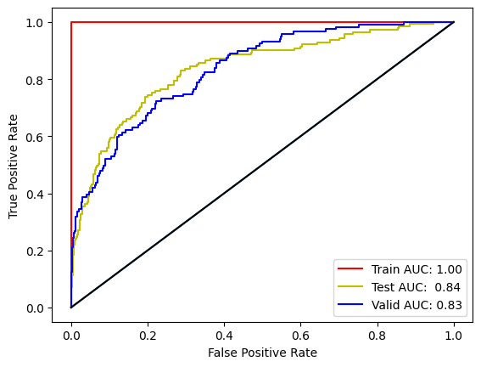
Sepsis 30-day mortality prediction using XGBoost
#Plot the ROC Curves - ensure to use the predicted probabilities and not the predicted values
We see that the XGBoost model using the default hyperparameters produces an AUC that is slightly below that generated in the research paper of 0.857 [0.839–0.876] as seen in Figure 4 on the website: https://www.ncbi.nlm.nih.gov/pmc/articles/PMC7720497/
Let’s analyze our model using learning curves and see if we can finetune the hyperparameters to bring our results more inline with those from the paper.

Slide 10
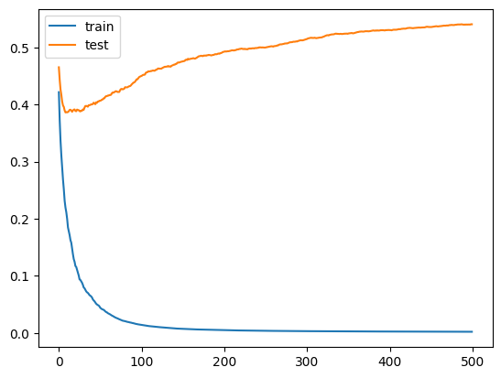
Sepsis 30-day mortality prediction using XGBoost
In the following section we will look at the learning curves for the model and then look to tune the model to increase its efficacy.
# plot learning curve of an XGBoost model
from sklearn.datasets import make_classification
from sklearn.model_selection import train_test_split
from sklearn.metrics import accuracy_score
from xgboost import XGBClassifier
from matplotlib import pyplot
# define the model
model = XGBClassifier(n_estimators=500)
# define the datasets to evaluate each iteration
evalset = [(X_train, y_train), (X_test,y_test)]
# fit the model
model.fit(X_train, y_train, eval_metric='logloss', eval_set=evalset, verbose=0)
# evaluate performance
yhat = model.predict(X_test)
score = accuracy_score(y_test, yhat)
# retrieve performance metrics
results = model.evals_result()
# plot learning curves
pyplot.plot(results['validation_0']['logloss'], label='train')
pyplot.plot(results['validation_1']['logloss'], label='test')
# show the legend
pyplot.legend()
# show the plot
pyplot.show()
print("Accuracy: %.2f%%" % (score * 100.0))
Accuracy: 83.63%
The plot shows learning curves for the train and test datasets where the x-axis is the number of iterations (or number of trees) of the algorithm while the y-axis is the logloss of the model. Each line shows the logloss per iteration for a given dataset.
From the learning curves, we can see that the performance of the model on the training dataset (blue line) has a lower loss than the performance of the model on the test dataset (orange line). This is an expected outcome though the shape of the test curve is of some concern. Let's see if we can improve the model through fine tuning of the hyperparameters.

Slide 11
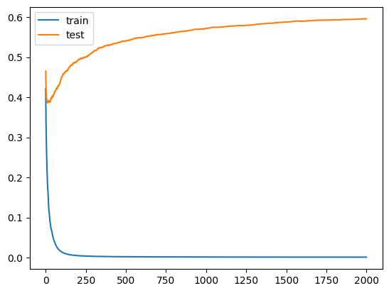
Sepsis 30-day mortality prediction using XGBoost
Tuning the XGBoost model using learning curves: Increasing the number of iterations
#Increasing the number of iterations
#This can be achieved by increasing the estimators variable.
# plot learning curve of an xgboost model
from sklearn.datasets import make_classification
from sklearn.model_selection import train_test_split
from sklearn.metrics import accuracy_score
from xgboost import XGBClassifier
from matplotlib import pyplot
# define the model
model = XGBClassifier(n_estimators=2000)
# define the datasets to evaluate each iteration
evalset = [(X_train, y_train), (X_test,y_test)]
# fit the model
model.fit(X_train, y_train, eval_metric='logloss', eval_set=evalset, verbose=0)
# evaluate performance
yhat = model.predict(X_test)
score = accuracy_score(y_test, yhat)
# retrieve performance metrics
results = model.evals_result()
# plot learning curves
pyplot.plot(results['validation_0']['logloss'], label='train')
pyplot.plot(results['validation_1']['logloss'], label='test')
# show the legend
pyplot.legend()
# show the plot
pyplot.show()
print("Accuracy: %.2f%%" % (score * 100.0))
Accuracy: 83.19%
Increasing the number of iterations appears to reduce the accuracy. Ideally we would want to see the difference between the logloss of the train and test data to converge and not increase. Perhaps if we maintain the 2000 iterations and adjust other hyperparameters, we may increase the accuracy of the model.

Slide 12
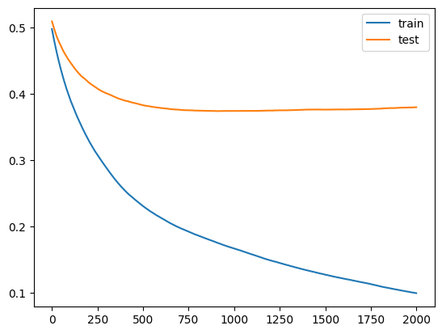
Sepsis 30-day mortality prediction using XGBoost
Tuning the XGBoost model using learning curves: Slowing down the learning rate (eta)
#Slowing down the learning rate
# plot learning curve of an xgboost model
from sklearn.datasets import make_classification
from sklearn.model_selection import train_test_split
from sklearn.metrics import accuracy_score
from xgboost import XGBClassifier
from matplotlib import pyplot
# define the model
model = XGBClassifier(n_estimators=500, eta=0.005)
# define the datasets to evaluate each iteration
evalset = [(X_train, y_train), (X_test,y_test)]
# fit the model
model.fit(X_train, y_train, eval_metric='logloss', eval_set=evalset, verbose=0)
# evaluate performance
yhat = model.predict(X_test)
score = accuracy_score(y_test, yhat)
# retrieve performance metrics
results = model.evals_result()
# plot learning curves
pyplot.plot(results['validation_0']['logloss'], label='train')
pyplot.plot(results['validation_1']['logloss'], label='test')
# show the legend
pyplot.legend()
# show the plot
pyplot.show()
print("Accuracy: %.2f%%" % (score * 100.0))
Accuracy: 83.77%
We see an increase in accuracy in this case to 83.77%.

Slide 13
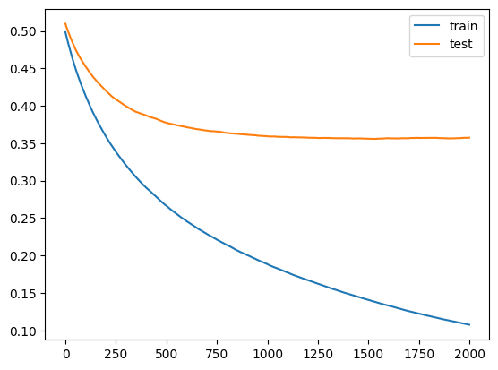
Sepsis 30-day mortality prediction using XGBoost
Tuning the XGBoost model using learning curves: Regularization - reducing the number of samples and features used to construct each tree in the ensemble.
#Regularization
## plot learning curve of an xgboost model
from sklearn.datasets import make_classification
from sklearn.model_selection import train_test_split
from sklearn.metrics import accuracy_score
from xgboost import XGBClassifier
from matplotlib import pyplot
# define the model
model = XGBClassifier(n_estimators=2000, eta=0.005, subsample=0.5, colsample_bytree=0.5)
# define the datasets to evaluate each iteration
evalset = [(X_train, y_train), (X_test,y_test)]
# fit the model
model.fit(X_train, y_train, eval_metric='logloss', eval_set=evalset, verbose=0)
# evaluate performance
yhat = model.predict(X_test)
score = accuracy_score(y_test, yhat)
# retrieve performance metrics
results = model.evals_result()
# plot learning curves
pyplot.plot(results['validation_0']['logloss'], label='train')
pyplot.plot(results['validation_1']['logloss'], label='test')
# show the legend
pyplot.legend()
# show the plot
pyplot.show()
print("Accuracy: %.2f%%" % (score * 100.0))
Accuracy: 85.09%
We see an increase in accuracy in this case to 85.09%.

Slide 14
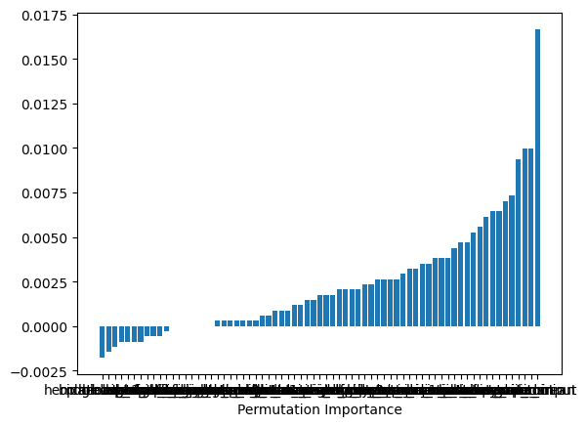
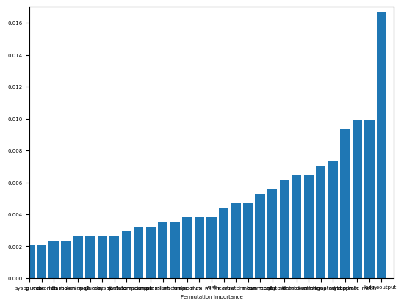
Sepsis 30-day mortality prediction using XGBoost
Tuning the XGBoost model using learning curves: Feature Selection (analyzing features from the dataset have the greatest importance to the model efficacy)
#Feature selection
from sklearn.inspection import permutation_importance
perm_importance = permutation_importance(model, X_test, y_test)
sorted_idx = perm_importance.importances_mean.argsort()
plt.bar(X.columns[sorted_idx], perm_importance.importances_mean[sorted_idx])
plt.xlabel("Permutation Importance")
cutoff = 30
plt.rc('font', size=5)
plt.bar(X.columns[sorted_idx], perm_importance.importances_mean[sorted_idx])
plt.ylim(0.000,0.016)
plt.xlim(len(sorted_idx)-cutoff,len(sorted_idx))
plt.xlabel("Permutation Importance")
Note that given the process by which this part of the analysis is run, your results may differ than what is shown.
That chart is a bit messy. Let's look at the most important features as we see a number of them have negative or minimal importance to the model.
Let's rerun the XGBoost analysis with our updated model and the condensed feature list.

Slide 15
Sepsis 30-day mortality prediction using XGBoost
X_new = df_sepsis[X.columns[sorted_idx][len(sorted_idx)-cutoff:len(sorted_idx)]]
Y = df_sepsis[['thirtyday_expire_flag']]
#Split data into test and training sets
seed = 42
test_size = 0.30
X_train, X_test, y_train, y_test = train_test_split(X_new, Y, test_size=test_size, random_state=seed)
#Split test data equally into validation and test sets
X_valid = X_test.sample(frac = 0.5, random_state=seed)
X_test = X_test.drop(X_valid.index)
y_valid = y_test.sample(frac = 0.5, random_state=seed)
y_test = y_test.drop(y_valid.index)
#Train the model
# fit model on training data
model_XGB = XGBClassifier(n_estimators=2000, eta=0.005, subsample=0.5, colsample_bytree=0.5)
evalset = [(X_train, y_train), (X_test, y_test)]
model_XGB.fit(X_train, y_train, eval_metric='logloss', eval_set=evalset, verbose=0)
Generate statistics on the model to determine its prediction characteristics.
In this portion of the code in the Jupyter notebook, we are looking to analyze the model’s efficacy. We reuse functions from the earlier analysis.
We see the following results after running the code:
Data Set | Model AUC | Model Accuracy | Recall: True Positive | Specificity: True Negative | Fall Out: False Positive | Miss Rate: False Negative | Precision: Positive Results Relative to Predicted Positive Results
Train | 99.93% | 96.93% | 100.00% | 84.42% | 15.58% | 0.00% | 96.32%
Test | 82.85% | 84.06% | 97.61% | 31.91% | 68.09% | 2.39% | 84.66%
Valid | 83.94% | 86.55% | 96.64% | 38.66% | 61.34% | 3.36% | 88.21%

Slide 16
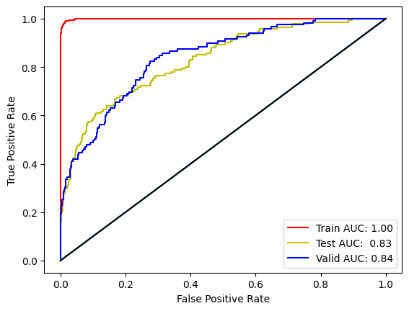
Sepsis 30-day mortality prediction using XGBoost
#Plot the ROC Curves - ensure to use the predicted probabilities and not the predicted values
We do see marginal increases in both model accuracy and AUC when using the updated XGBoost model using regularization, increase iterations, and a slower learning rate coupled with the updated feature list. We will use these results when comparing and seeking improvement using LightGBM and CatBoost.
Before doing so, we will run our model using the condensed feature list as defined in the research paper in Table 3 to see if the results are better than our own.

Slide 17
Sepsis 30-day mortality prediction using XGBoost
#pull the feature names from table 3 from the paper website
X_paper = df_sepsis[['urineoutput', 'lactate_min', 'bun_mean', 'sysbp_min', 'metastatic_cancer', 'inr_max', 'age', 'sodium_max', 'aniongap_max', 'creatinine_min', 'spo2_mean']]
Y_paper = df_sepsis[['thirtyday_expire_flag']]
#Split data into test and training sets
seed = 42
test_size = 0.30
X_train_paper, X_test_paper, y_train_paper, y_test_paper = train_test_split(X_paper, Y_paper, test_size=test_size, random_state=seed)
#Split test data equally into validation and test sets
X_valid_paper = X_test_paper.sample(frac = 0.5, random_state=seed)
X_test_paper = X_test_paper.drop(X_valid.index)
y_valid_paper = y_test_paper.sample(frac = 0.5, random_state=seed)
y_test_paper = y_test_paper.drop(y_valid.index)
#Train the model
# fit model on training data
model_XGB_paper = XGBClassifier(n_estimators=2000, eta=0.005) #, subsample=0.5, colsample_bytree=0.5) #we are removing regularization given the small feature list
evalset_paper = [(X_train_paper, y_train_paper), (X_test_paper, y_test_paper)]
model_XGB_paper.fit(X_train_paper, y_train_paper, eval_metric='logloss', eval_set=evalset_paper, verbose=0)
Generate statistics on the model to determine its prediction characteristics.
In this portion of the code in the Jupyter notebook, we are looking to analyze the model’s efficacy. We reuse functions from the earlier analysis.
We see the following results after running the code:
Data Set | Model AUC | Model Accuracy | Recall: True Positive | Specificity: True Negative | Fall Out: False Positive | Miss Rate: False Negative | Precision: Positive Results Relative to Predicted Positive Results
Train | 98.89% | 94.42% | 99.96% | 71.86% | 28.14% | 0.04% | 93.54%
Test | 81.80% | 82.31% | 95.58% | 31.21% | 68.79% | 4.42% | 84.25%
Valid | 80.41% | 85.67% | 95.75% | 37.82% | 62.18% | 4.25% | 87.97%

Slide 18
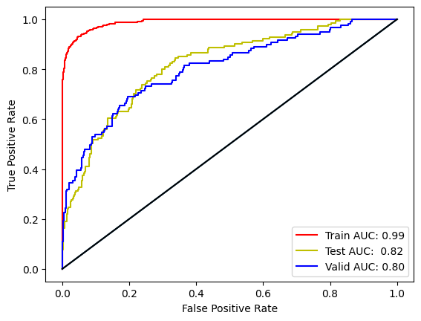
Sepsis 30-day mortality prediction using XGBoost
#Plot the ROC Curves - ensure to use the predicted probabilities and not the predicted values
Compare the model using the research paper features vs our own set of features
#Compare the model using the research paper features vs our own set of features
print('Model AUC')
print('Research Paper Model: %.2f%%'%(roc_auc_score(y_valid_paper, y_valid_paper_prob)*100))
print('Our Tuned Model: %.2f%%'%(roc_auc_score(y_valid, y_valid_prob)*100))
print('')
print('Model Accuracy')
print('Research Paper Model: %.2f%%'%(calc_accuracy(y_valid_paper, y_valid_paper_preds)*100))
print('Our Tuned Model: %.2f%%'%(calc_accuracy(y_valid, y_valid_preds)*100))
print('')
Feature Set | Model AUC on Validation Dataset | Model Accuracy on Validation Dataset
Research Paper | 80.41% | 85.67%
Our Tuned Model | 83.94% | 86.55%
Our tuned model produces results that show improvement relative to the research model paper. However, we will use the feature list from the research paper for comparison's sake as we are looking to show improved performance relative to the paper's results and keep our custom feature dataset (X_new) for potential future use.

Slide 19
Predicting 30-day mortality due to sepsis using lightgbm

Slide 20
Sepsis 30-day mortality prediction using LightGBM
Loading Model and Necessary Libraries
!pip install lightgbm
import lightgbm as lgb
from lightgbm import LGBMClassifier
from numpy import mean
from numpy import std
from sklearn.datasets import make_classification
from sklearn.model_selection import cross_val_score
from sklearn.model_selection import RepeatedStratifiedKFold

Slide 21
Sepsis 30-day mortality prediction using LightGBM
Defining, fitting, and running the model
#Define the model
model_LGBM = LGBMClassifier()
#Using the feature mapping from the research paper: "X_paper" and the same target/output "Y_paper"
#fit the model on the same training data we used in the updated XGBoost model
model_LGBM.fit(X_train_paper, y_train_paper)
#We will evaluate the model using repeated stratified k-fold cross-validation with three repeats and 10 folds.
#We will report the mean and standard deviation of the accuracy of the model across all repeats and folds.
#evaluate the model
cv = RepeatedStratifiedKFold(n_splits=10, n_repeats=3, random_state=1)
n_scores = cross_val_score(model_LGBM, X_paper, Y_paper, scoring='accuracy', cv=cv, n_jobs=-1)
# report performance
print('')
print('Accuracy: %.2f%%' % (mean(n_scores)*100))
The model using default hyperparameters reports an accuracy of 83.67% which is below that for the XGBoost model using the research paper features (85.67%) and below our tuned XGBoost model using our own feature list (86.55%).
Let's see if we can adjust some parameters to improve its accuracy. We could use either grid search or random search to generate parameters. Given the computational intensity of running these over a large number of parameters and in the vein of teaching one to test multiple values across multiple parameters, we have chosen to address each parameter in a step-by-step manner, using the optimal values from earlier parameterization in subsequent parameter testing.

Slide 22
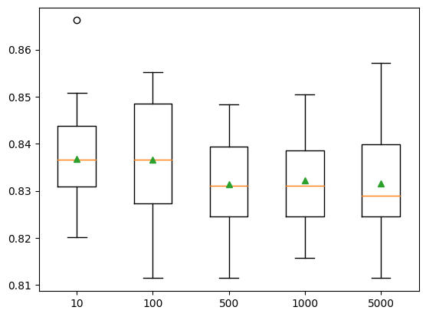
Sepsis 30-day mortality prediction using LightGBM
Tuning the LightGBM model: Increasing the number of trees
#create a list of models using various numbers of trees
def get_models():
models = dict()
trees = [10, 100, 500, 1000, 5000]
for i in trees:
models[str(i)] = LGBMClassifier(n_estimators=i)
return models
#evaluate a given model using cross-validation
def evaluate_model(model):
cv = RepeatedStratifiedKFold(n_splits=10, n_repeats=3, random_state=1)
scores = cross_val_score(model, X_paper, Y_paper, scoring='accuracy', cv=cv, n_jobs=-1)
return scores
#get the models to evaluate
models = get_models()
# evaluate the models and store results
results, names = list(), list()
for name, model in models.items():
scores = evaluate_model(model)
results.append(scores)
names.append(name)
print('# of Trees: %s %.2f%%)' % (name, mean(scores)*100))
#plot model performance for comparison
pyplot.boxplot(results, labels=names, showmeans=True)
pyplot.show()
# of Trees | Accuracy
10 | 83.68%
100 | 83.67%
500 | 83.14%
1000 | 83.21%
5000 | 83.16%
We do not see any improvement in increasing the number of trees over the default of 100 trees and in fact see an ever so slight increase in efficacy in less trees. However, given the shape of the box-and-whisker plot, we will maintain the default of 100 going forward.

Slide 23
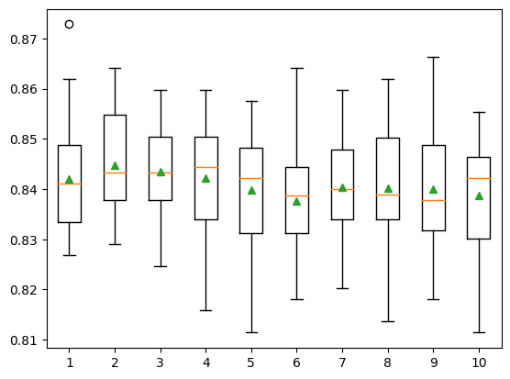
Sepsis 30-day mortality prediction using LightGBM
Tuning the LightGBM model: Adjusting the tree depth
#Adjusting the tree depth
#create a list of models using various depths of trees
def get_models():
models = dict()
for i in range(1,11):
models[str(i)] = LGBMClassifier(max_depth=i, num_leaves=2**i)
return models
#evaluate a given model using cross-validation
def evaluate_model(model):
cv = RepeatedStratifiedKFold(n_splits=10, n_repeats=3, random_state=1)
scores = cross_val_score(model, X_paper, Y_paper, scoring='accuracy', cv=cv, n_jobs=-1)
return scores
#get the models to evaluate
models = get_models()
# evaluate the models and store results
results, names = list(), list()
for name, model in models.items():
scores = evaluate_model(model)
results.append(scores)
names.append(name)
print('Tree Depth: %s %.2f%%)' % (name, mean(scores)*100))
#plot model performance for comparison
pyplot.boxplot(results, labels=names, showmeans=True)
pyplot.show()
Tree Depth | Accuracy
1 | 84.20%
2 | 84.48%
3 | 84.35%
4 | 84.22%
5 | 83.98%
6 | 83.77%
7 | 84.03%
8 | 84.02%
9 | 84.00%
10 | 83.86%
We see the accuracy peak at a tree depth of 2 and will use this going forward.

Slide 24
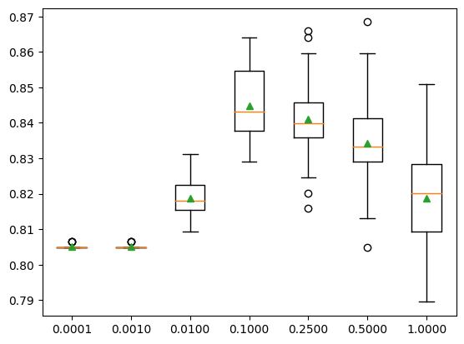
Sepsis 30-day mortality prediction using LightGBM
Tuning the LightGBM model: Adjusting the learning rate
#Adjusting the learning rate
#create a list of models using various learning rates
def get_models():
models = dict()
rates = [0.0001, 0.001, 0.01, 0.1, 0.25, 0.5, 1.0]
for r in rates:
key = '%.4f' % r
models[key] = LGBMClassifier(max_depth=2, num_leaves=4,learning_rate=r)
return models
#evaluate a given model using cross-validation
def evaluate_model(model):
cv = RepeatedStratifiedKFold(n_splits=10, n_repeats=3, random_state=1)
scores = cross_val_score(model, X_paper, Y_paper, scoring='accuracy', cv=cv, n_jobs=-1)
return scores
#get the models to evaluate
models = get_models()
# evaluate the models and store results
results, names = list(), list()
for name, model in models.items():
scores = evaluate_model(model)
results.append(scores)
names.append(name)
print('Learning Rate: %s %.2f%%)' % (name, mean(scores)*100))
#plot model performance for comparison
pyplot.boxplot(results, labels=names, showmeans=True)
pyplot.show()
Learning Rate | Accuracy
0.0001 | 80.50%
0.0010 | 80.50%
0.0100 | 81.87%
0.1000 | 84.48%
0.2500 | 84.10%
0.5000 | 83.42%
1.0000 | 81.88%
We see the accuracy peak at a learning rate of 0.10 and will use this level in future analysis.

Slide 25
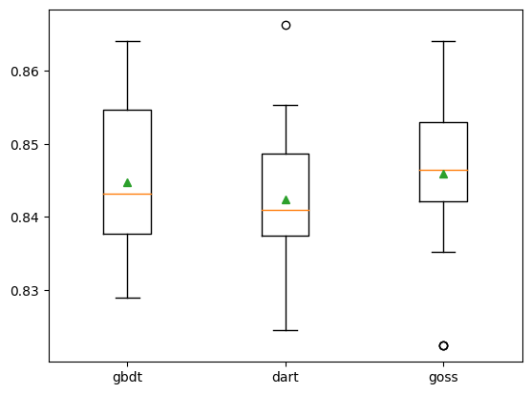
Sepsis 30-day mortality prediction using LightGBM
Tuning the LightGBM model: Adjusting the boosting method
#Adjusting the Boosting algorithm
#LightGBM includes three different boosting algorithms which we will assess in our model
#gbdt: Gradient Boosting Decision Tree (GDBT)
#dart: Dropouts meet Multiple Additive Regression Trees (DART)
#goss: Gradient-based One-Side Sampling (GOSS)
#create a list of models using various boosting algorithms
def get_models():
models = dict()
types = ['gbdt', 'dart', 'goss']
for t in types:
models[t] = LGBMClassifier(max_depth=2, num_leaves=4,learning_rate=0.10, boosting_type=t)
return models
#evaluate a given model using cross-validation
def evaluate_model(model):
cv = RepeatedStratifiedKFold(n_splits=10, n_repeats=3, random_state=1)
scores = cross_val_score(model, X_paper, Y_paper, scoring='accuracy', cv=cv, n_jobs=-1)
return scores
#get the models to evaluate
models = get_models()
# evaluate the models and store results
results, names = list(), list()
for name, model in models.items():
scores = evaluate_model(model)
results.append(scores)
names.append(name)
print('Boosting Type: %s %.2f%%)' % (name, mean(scores)*100))
#plot model performance for comparison
pyplot.boxplot(results, labels=names, showmeans=True)
pyplot.show()
Boosting Method | Accuracy
GBDT | 84.48%
DART | 84.24%
GOSS | 84.59%
We see a slight improvement using GOSS relative to either GBDT or DART.
Now we have our tuned LightGBM model using 100 trees, a depth of 2, a learning rate of 0.10, and boosting algorithm GOSS.

Slide 26
Sepsis 30-day mortality prediction using LightGBM
Let's run similar characteristics on this model as we did for XGBoost.
#Define the model
model_LGBM = LGBMClassifier(max_depth=2, num_leaves=4,learning_rate=0.10, boosting_type='dart')
#fit the model
model_LGBM.fit(X_train_paper, y_train_paper)
Generate statistics on the model to determine its prediction characteristics.
In this portion of the code in the Jupyter notebook, we are looking to analyze the model’s efficacy. We reuse functions from the earlier analysis.
We see the following results after running the code:
Data Set | Model AUC | Model Accuracy | Recall: True Positive | Specificity: True Negative | Fall Out: False Positive | Miss Rate: False Negative | Precision: Positive Results Relative to Predicted Positive Results
Train | 82.87% | 84.42% | 98.79% | 25.91% | 74.09% | 1.21% | 84.45%
Test | 80.86% | 84.06% | 99.45% | 24.82% | 75.18% | 0.55% | 83.59%
Valid | 81.66% | 87.13% | 98.94% | 31.09% | 68.91% | 1.06% | 87.21%

Slide 27
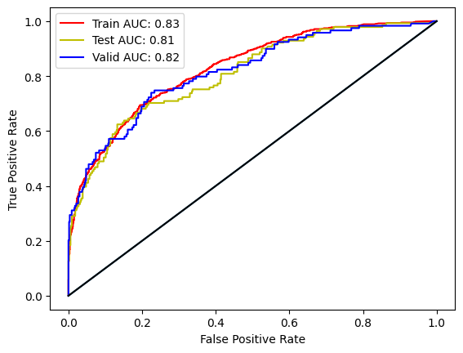
Sepsis 30-day mortality prediction using LightGBM
#Plot the ROC Curves - ensure to use the predicted probabilities and not the predicted values
We see an increase in both AUC and Accuracy when comparing these results to the XGBoost model using the research paper features.
We also see an increase in model accuracy but a decrease in AUC when using the LightGBM model relative to the XGBoost model using our tuned model features.
We will use these LightGBM results when comparing and seeking improvement using CatBoost.
Model & Feature Set | Model AUC on Validation Dataset | Model Accuracy on Validation Dataset
XGBoost: Research Paper | 80.41% | 85.67%
XGBoost: Our Tuned Model | 83.94% | 86.55%
LightGBM: Research Paper | 81.66% | 87.13%

Slide 28
Predicting 30-day mortality due to sepsis using catboost

Slide 29
Sepsis 30-day mortality prediction using CatBoost
Loading Model and Necessary Libraries
!pip install catboost
import catboost as catb
from numpy import mean
from numpy import std
from sklearn.datasets import make_classification
from catboost import CatBoostClassifier
from sklearn.model_selection import cross_val_score
from sklearn.model_selection import RepeatedStratifiedKFold
from matplotlib import pyplot

Slide 30
Sepsis 30-day mortality prediction using CatBoost
Defining, fitting, and running the model
#Define the model
model_CATB = CatBoostClassifier(verbose=0)
#Using the feature mapping from the research paper: "X_paper" and the same target/output "Y_paper"
#fit the model on the same training data we used in the updated XGBoost model
model_CATB.fit(X_train_paper, y_train_paper)
#We will evaluate the model using the same structure as that for LightGBM:
#Repeated stratified k-fold cross-validation with three repeats and 10 folds.
#We will report the mean and standard deviation of the accuracy of the model across all repeats and folds.
#evaluate the model
cv = RepeatedStratifiedKFold(n_splits=10, n_repeats=3, random_state=1)
n_scores = cross_val_score(model_CATB, X_paper, Y_paper, scoring='accuracy', cv=cv, n_jobs=-1, error_score='raise')
# report performance
print('Accuracy: %.2f%%' % (mean(n_scores)*100))
The model using default hyperparameters reports an accuracy of 84.40% which is below that for the XGBoost model using the research paper features (85.67%), below the tuned XGBoost model using our feature list (86.55%), and below our tuned LightGBM model using the research paper feature list (87.13%).
Similar to the LightGBM approach, let's finetune the hyperparameters to see if we can increase the model accuracy. Let's see if we can adjust some parameters to improve its accuracy. We could use either grid search or random search to generate parameters. Given the computational intensity of running these over a large number of parameters and in the vein of teaching one to test multiple values across multiple parameters, we have chosen to address each parameter in a step-by-step manner, using the optimal values from earlier parameterization in subsequent parameter testing.

Slide 31
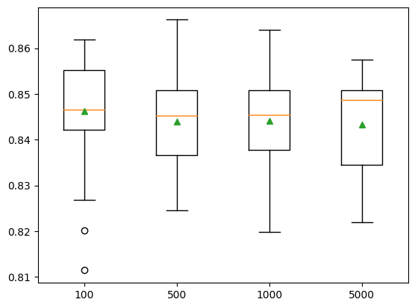
Sepsis 30-day mortality prediction using CatBoost
Tuning the CatBoost model: Increasing the number of iterations
#Increasing the number of model iterations - this will take some time to run
#create a list of models using various numbers of iterations
def get_models():
models = dict()
iters = [100, 500, 1000, 5000]
for i in iters:
models[str(i)] = CatBoostClassifier(iterations=i, verbose=0)
return models
#evaluate a given model using cross-validation
def evaluate_model(model):
cv = RepeatedStratifiedKFold(n_splits=10, n_repeats=3, random_state=1)
scores = cross_val_score(model, X_paper, Y_paper, scoring='accuracy', cv=cv, n_jobs=-1, error_score='raise')
return scores
#get the models to evaluate
models = get_models()
# evaluate the models and store results
results, names = list(), list()
for name, model in models.items():
scores = evaluate_model(model)
results.append(scores)
names.append(name)
print('# of Iterations: %s %.2f%%)' % (name, mean(scores)*100))
#plot model performance for comparison
pyplot.boxplot(results, labels=names, showmeans=True)
pyplot.show()
# of Iterations | Accuracy
100 | 84.62%
500 | 84.39%
1000 | 84.40%
5000 | 84.32%
We do not see any improvement in increasing the number of iterations over 100 and will use this value going forward.

Slide 32
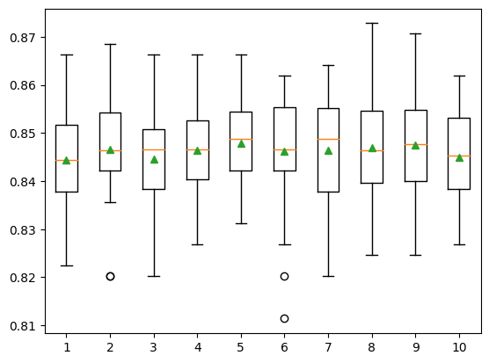
Sepsis 30-day mortality prediction using CatBoost
Tuning the CatBoost model: Adjusting the tree depth
#Adjusting the tree depth - this too will take some time to run
#create a list of models using various depths of trees
def get_models():
models = dict()
for i in range(1,11):
models[str(i)] = CatBoostClassifier(depth=i, iterations=100, verbose=0)
return models
#evaluate a given model using cross-validation
def evaluate_model(model):
cv = RepeatedStratifiedKFold(n_splits=10, n_repeats=3, random_state=1)
scores = cross_val_score(model, X_paper, Y_paper, scoring='accuracy', cv=cv, n_jobs=-1, error_score='raise')
return scores
#get the models to evaluate
models = get_models()
# evaluate the models and store results
results, names = list(), list()
for name, model in models.items():
scores = evaluate_model(model)
results.append(scores)
names.append(name)
print('Tree Depth: %s %.2f%%)' % (name, mean(scores)*100))
#plot model performance for comparison
pyplot.boxplot(results, labels=names, showmeans=True)
pyplot.show()
Tree Depth | Accuracy
1 | 84.43%
2 | 84.66%
3 | 84.46%
4 | 84.63%
5 | 84.79%
6 | 84.62%
7 | 84.64%
8 | 84.70%
9 | 84.74%
10 | 84.49%
We see the accuracy peak at a tree depth of 5 and will use this going forward.

Slide 33
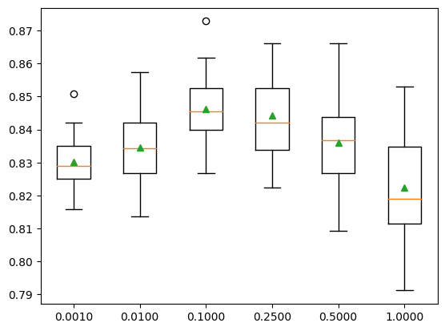
Sepsis 30-day mortality prediction using CatBoost
Tuning the CatBoost model: Adjusting the learning rate
#Adjusting the learning rate
#create a list of models using various learning rates
def get_models():
models = dict()
rates = [0.001, 0.01, 0.1, 0.25, 0.5, 1.0]
for r in rates:
key = '%.4f' % r
models[key] = CatBoostClassifier(learning_rate=r, depth=5, iterations=100, verbose=0)
return models
#evaluate a given model using cross-validation
def evaluate_model(model):
cv = RepeatedStratifiedKFold(n_splits=10, n_repeats=3, random_state=1)
scores = cross_val_score(model, X_paper, Y_paper, scoring='accuracy', cv=cv, n_jobs=-1, error_score='raise')
return scores
#get the models to evaluate
models = get_models()
# evaluate the models and store results
results, names = list(), list()
for name, model in models.items():
scores = evaluate_model(model)
results.append(scores)
names.append(name)
print('Learning Rate: %s %.2f%%)' % (name, mean(scores)*100))
#plot model performance for comparison
pyplot.boxplot(results, labels=names, showmeans=True)
pyplot.show()
Learning Rate | Accuracy
0.0010 | 83.02%
0.0100 | 83.45%
0.1000 | 84.62%
0.2500 | 84.43%
0.5000 | 83.59%
1.0000 | 82.25%
We see the accuracy peak at a learning rate of 0.10 and will use this level in future analysis.

Slide 34
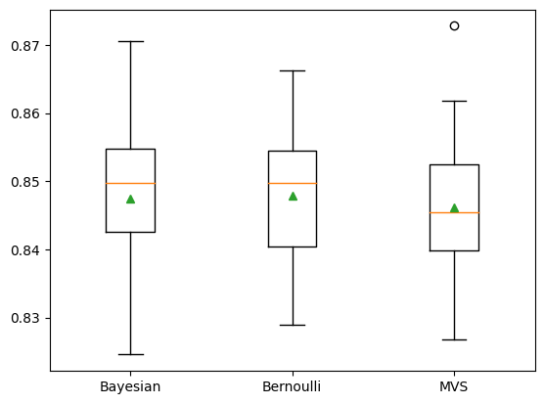
Sepsis 30-day mortality prediction using CatBoost
Tuning the CatBoost model: Adjusting the bootstrap method: this can implement regularization and improve speed
#CatBoost includes four different bootstrap methods which we will assess in our model
#Bayesian
#Bernoulli
#MVS
#Poisson (supported for GPU only so will exclude from this analysis)
#create a list of models using various numbers of trees incorporating depth from previous example
def get_models():
models = dict()
types = ['Bayesian', 'Bernoulli', 'MVS']
for t in types:
models[t] = CatBoostClassifier(bootstrap_type=t, learning_rate=0.10, depth=5, iterations=100, verbose=0)
return models
#evaluate a given model using cross-validation
def evaluate_model(model):
cv = RepeatedStratifiedKFold(n_splits=10, n_repeats=3, random_state=1)
scores = cross_val_score(model, X_paper, Y_paper, scoring='accuracy', cv=cv, n_jobs=-1, error_score='raise')
return scores
#get the models to evaluate
models = get_models()
# evaluate the models and store results
results, names = list(), list()
for name, model in models.items():
scores = evaluate_model(model)
results.append(scores)
names.append(name)
print('Bootstrap Type: %s %.2f%%)' % (name, mean(scores)*100))
#plot model performance for comparison
pyplot.boxplot(results, labels=names, showmeans=True)
pyplot.show()
Bootstrap Method | Accuracy
Bayesian | 84.75%
Bernoulli | 84.78%
MVS | 84.62%
We will use the Bernouli bootstrap method given its highest accuracy, higher than the prior parameter run using the default.
Now we have our tuned CatBoost model using 100 iterations, a depth of 5, a learning rate of 0.10, and the Bernoulli bootstrap algorithm.

Slide 35
Sepsis 30-day mortality prediction using CatBoost
Let's run similar characteristics on this model as we did for XGBoost and LightGBM.
#Define the model
model_CATB = CatBoostClassifier(bootstrap_type='Bernoulli', learning_rate=0.10, depth=5, iterations=100, verbose=0)
#fit the model
model_CATB.fit(X_train_paper, y_train_paper)
Generate statistics on the model to determine its prediction characteristics.
In this portion of the code in the Jupyter notebook, we are looking to analyze the model’s efficacy. We reuse functions from the earlier analysis.
We see the following results after running the code:
Data Set | Model AUC | Model Accuracy | Recall: True Positive | Specificity: True Negative | Fall Out: False Positive | Miss Rate: False Negative | Precision: Positive Results Relative to Predicted Positive Results
Train | 86.59% | 86.18% | 98.44% | 36.25% | 63.75% | 1.56% | 86.28%
Test | 83.00% | 84.50% | 97.97% | 32.62% | 67.38% | 2.03% | 84.85%
Valid | 83.79% | 87.13% | 97.70% | 36.97% | 63.03% | 2.30% | 88.04%

Slide 36
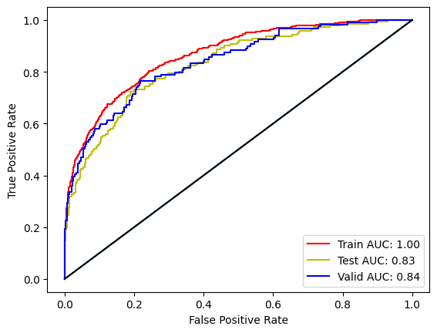
Sepsis 30-day mortality prediction using CatBoost
#Plot the ROC Curves - ensure to use the predicted probabilities and not the predicted values
We see an increase in both AUC and Accuracy when comparing these results to the XGBoost model using the research paper features.
We see an minor decrease in AUC but an increase in Accuracy when comparing these results to the XGBoost model using our tuned model features.
The CatBoost model also produces a higher AUC and inline Accuracy as the LightGBM model using the research paper features.
Model & Feature Set | Model AUC on Validation Dataset | Model Accuracy on Validation Dataset
XGBoost: Research Paper | 80.41% | 85.67%
XGBoost: Our Tuned Model | 83.94% | 86.55%
LightGBM: Research Paper | 81.66% | 87.13%
CatBoost: Research Paper | 83.79% | 87.13%

Slide 37
Sepsis 30-day mortality prediction using CatBoost
For comparison, let's run the parameterized CatBoost model based on our custom features to compare to that for the features based on the research paper.
#Define the model
X_new = df_sepsis[X.columns[sorted_idx][len(sorted_idx)-cutoff:len(sorted_idx)]]
Y = df_sepsis[['thirtyday_expire_flag']]
#Train the model
# fit model on training data
model_CATB_cust = CatBoostClassifier(bootstrap_type='Bernoulli', learning_rate=0.10, depth=5, iterations=100, verbose=0)
#fit the model
model_CATB_cust.fit(X_cust_train, y_cust_train)
Generate statistics on the model to determine its prediction characteristics.
In this portion of the code in the Jupyter notebook, we are looking to analyze the model’s efficacy. We reuse functions from the earlier analysis.
We see the following results after running the code:
Data Set | Model AUC | Model Accuracy | Recall: True Positive | Specificity: True Negative | Fall Out: False Positive | Miss Rate: False Negative | Precision: Positive Results Relative to Predicted Positive Results
Train | 90.78% | 88.62% | 99.02% | 46.26% | 53.74% | 0.98% | 88.24%
Test | 82.89% | 84.50% | 97.61% | 34.04% | 65.96% | 2.39% | 85.07%
Valid | 83.78% | 86.40% | 96.99% | 36.13% | 63.87% | 3.01% | 87.82%

Slide 38
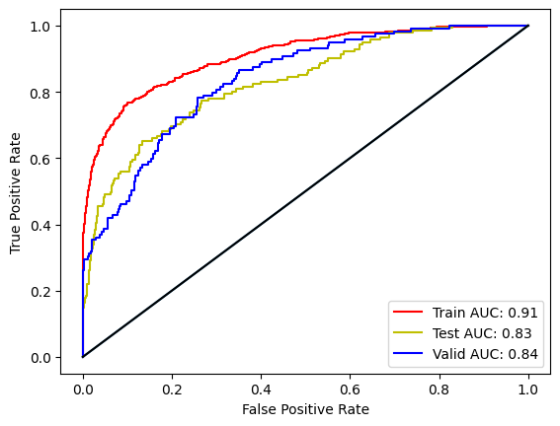
Sepsis 30-day mortality prediction using CatBoost
#Plot the ROC Curves - ensure to use the predicted probabilities and not the predicted values
We do not see any improvement in AUC or accuracy when analyzing CatBoost using our tuned model features relative to CatBoost using the research paper features.
Model & Feature Set | Model AUC on Validation Dataset | Model Accuracy on Validation Dataset
XGBoost: Research Paper | 80.41% | 85.67%
XGBoost: Our Tuned Model | 83.94% | 86.55%
LightGBM: Research Paper | 81.66% | 87.13%
CatBoost: Research Paper | 83.79% | 87.13%
CatBoost: Our Tuned Model | 83.78% | 86.40%

Slide 39
Analyzing the results across the machine learning models

Slide 40
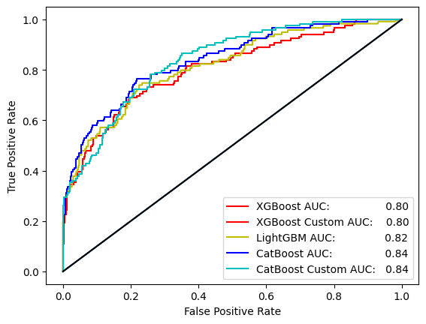
Sepsis 30-day mortality prediction using multiple models
Let's run similar characteristics across all our models. We see the following results after running the code.
Models with “Custom” refer to the use of our own feature list while models without “Custom” use the research paper features.
Comparison of Machine Learning Model Metrics
Model | XGBoost | XGBoost Custom | LightGBM | CatBoost | CatBoost Custom
AUC | 80.41% | 83.94% | 81.66% | 83.79% | 83.78%
Accuracy | 85.67% | 86.55% | 87.13% | 87.13% | 86.40%
Recall | 95.75% | 96.64% | 98.94% | 97.70% | 96.99%
Specificity | 37.82% | 38.66% | 31.09% | 36.97% | 36.13%
Fall Out | 62.18% | 61.34% | 68.91% | 63.03% | 63.87%
Miss Rate | 4.25% | 3.36% | 1.06% | 2.30% | 3.01%
Precision | 87.97% | 88.21% | 87.21% | 88.04% | 87.82%
While we do see varied characteristics showing improvement using our own feature list, we will assess on the following page the base XGBoost model versus the LightGMB and CatBoost models.
We would note an expectation that we could further improve prediction ability through a more detailed approach to feature selection and hyperparameter setting through the enhanced functionality in CatBoost but will leave that for future endeavors.

Slide 41
Sepsis 30-day mortality prediction using multiple models
We set out at the beginning of the tutorial to determine whether we could improve upon the models used in the research paper, "Predicting 30-days mortality for MIMIC-III patients with sepsis-3: a machine learning approach using XGboost" by Hou et al, which sought to use XGBoost as an alternative means to making predictions versus more traditional approaches such as SAPS-II score prediction and logistic regression. The paper concluded that XGBoost provides superior results to the traditional approaches. In particular, our objective was to determine whether using either of LightGBM or CatBoost would improve prediction ability and to learn how we may finetune hyperparameters of these models to increase model efficacy.
Model Stats & Improvement
Model | XGBoost | LightGBM | CatBoost
AUC | 80.41% | 81.66% | 83.78%
Accuracy | 85.67% | 87.13% | 86.40%
Recall | 95.75% | 98.94% | 96.99%
Specificity | 37.82% | 31.09% | 36.13%
Fall Out | 62.18% | 68.91% | 63.87%
Miss Rate | 4.25% | 1.06% | 3.01%
Precision | 87.97% | 87.21% | 87.82%
From the results, we see that both LightGBM and CatBoost provide improvement across most metrics associated with the efficacy of machine learning models when compared to XGBoost.
Of note, we see a strong improvement in AUC with the CatBoost model relative to the other models.
We would encourage further research into feature selection as we did see some improvement in our tuned model features when compared to the research paper features. Additionally, greater stratification into parameter testing may yield enhanced results across the models.
Denotes improvement relative to the XGBoost Model
Denotes improvement relative to both the XGBoost and LightGBM Models

Slide 42
Acknowledgements
Hou N, Li M, He L, Xie B, Wang L, Zhang R, Yu Y, Sun X, Pan Z, Wang K. Predicting 30-days mortality for MIMIC-III patients with sepsis-3: a machine learning approach using XGboost. J Transl Med. 2020 Dec 7;18(1):462. doi: 10.1186/s12967-020-02620-5. PMID: 33287854; PMCID: PMC7720497. also @ https://www.ncbi.nlm.nih.gov/pmc/articles/PMC7720497/
Johnson AEW, Pollard TJ, Shen L, Lehman LH, Feng M, Ghassemi M, Moody B, Szolovits P, Celi LA, Mark RG. MIMIC-III, a freely accessible critical care database. Scientific data. 2016 May 24;3(1):1-9.

